Slide 1

Automatic Seed Sowing and Spraying Agriculture Robot
Department of Electronics and Communication Engineering
SI.NO | NAME | USN | ROLL.NO
1) | Chandrashekhar Bhavi | 02FE21BEC020 | 21
2) | Jamuna Pulpatali | 02FE21BEC032 | 32
3) | Priyanka Budihal | 02FE21BEC054 | 52
4) | Pruthviraj Banoshi | 02FE22BEC058 | 56
Guide: Dr. Prabhakar Manage

Slide 2
Problem Statement :
Develop an automatic seed sowing and spraying agriculture robot to enhance efficiency , reduce labour dependency , and ensure precise seed placement for smart farming

Slide 3
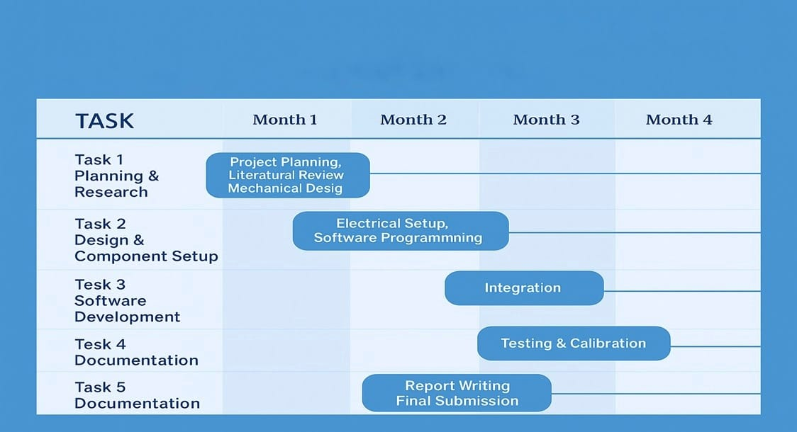
GANTT CHART

Slide 4
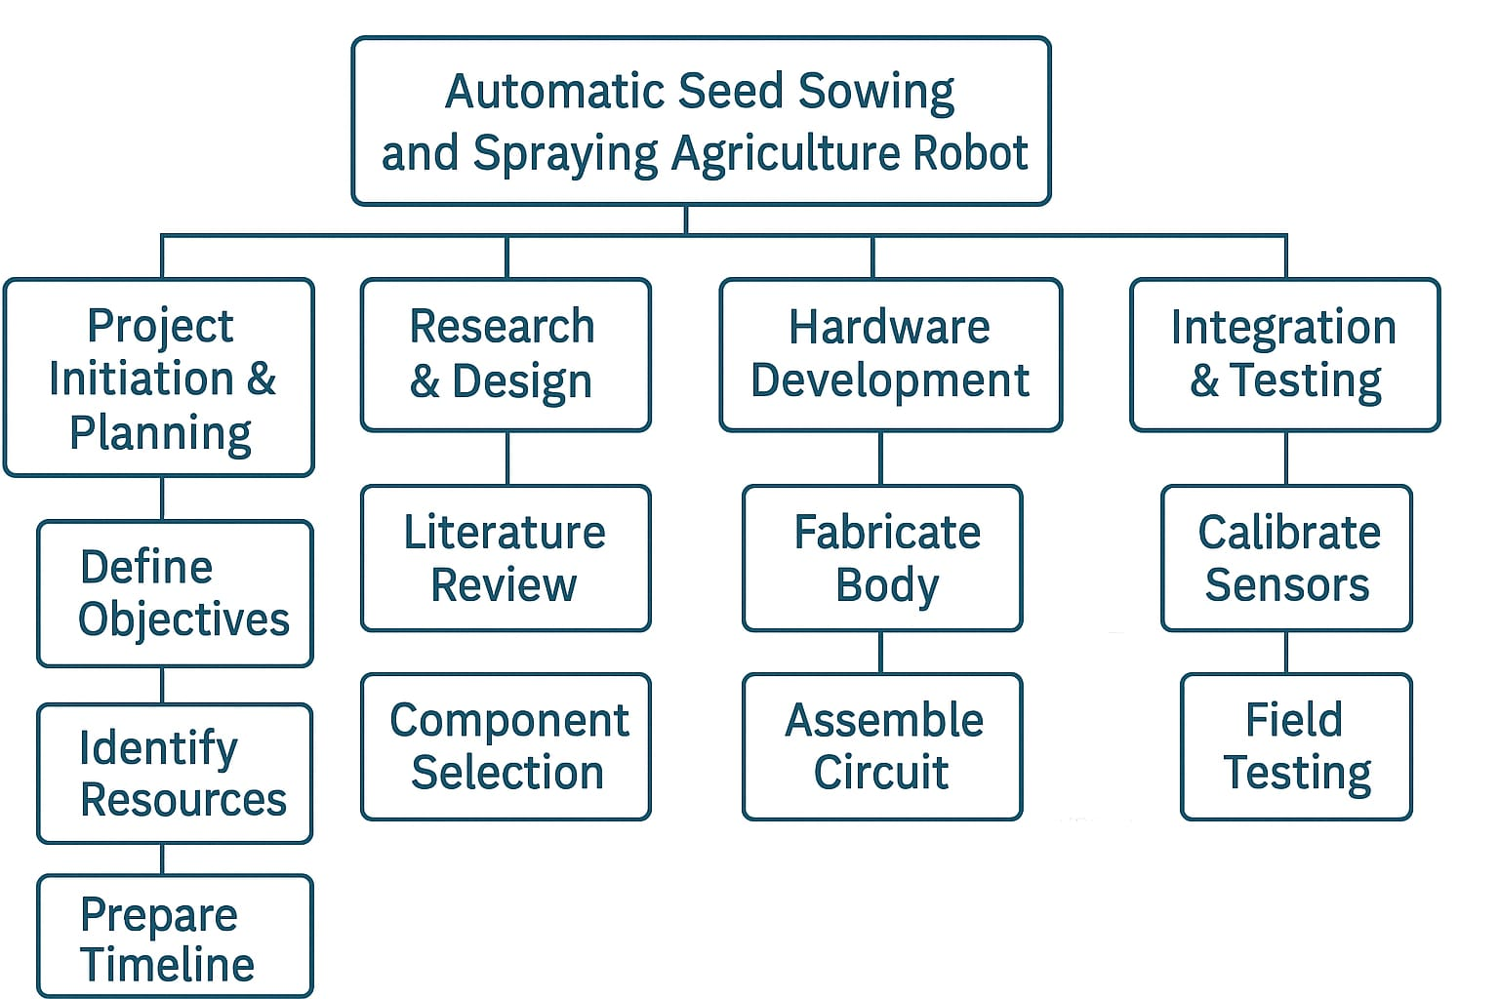
Work Breakdown Structure :

Slide 5
Specification :
Microcontroller: Arduino Mega
Chassis: 4-wheel platform
Motors: DC Motors (150 RPM) with L298N driver
Seed Mechanism: Servo-controlled dropper
Power Supply: 14.8V Li-ion
Battery Speed: 0.5 m/s (adjustable)
Seeding Interval: Configurable (e.g., every 10–20 cm)
Field Suitability: Small experimental plots

Slide 6
Identification :
Input | Output
Arduino code, sensor readings | Motor movement, seed dispensing
Software Bluetooth APK | Navigation control
Battery power | Operation of motors and sensors
Seed hopper filled | Timed seed drops at intervals

Slide 7

Functional Block Diagram :
Power Supply
(14.8V DC supply for motors,5V regulated output for Arduino and Bluetooth)
Arduino Mega 2560
(Main Controller)
54 digital i/o pins, 16 Analog inputs
Motor Driver(L298N)
Dual H-Bridge motor driver
Voltage:5V-35V
Current : up to 2A per channel
HC-05 Bluetooth Module
Communication : Serial UART
Voltage:5V logic level
Range: approx. 10 meters
2CH Relay Module
Dual H-Bridge motor driver
Voltage:5V-35V
Current : up to 2A per channel
4 × DC Geared Motors (150 RPM)
Rated Voltage:12V DC
RPM:150
Torque: Suitable for lightweight agricultural robots
Servo Motor(MG995)
Operating voltage:4.8V-6V
Control : PWM from Arduino
Micro Servo Motor
Operating voltage:4.8V-6V
Control : PWM from Arduino
Sprinkler Pump
Operating voltage:4.8V-6V
Flow rate: Based on requirement

Slide 8
Block Diagram Specification :
Power Supply
Input: 14.8V DC
Output:
14.8V DC for motors
5V regulated output for Arduino and Bluetooth
Purpose: Supplies power to all components in the system.
Arduino Mega 2560 (Main Controller)
Function: Central control unit
I/O Pins:
54 digital input/output pins
16 analog input pins
Power Supply: 5V regulated from power module
Communication: Controls peripherals via digital signals and PWM
Motor Driver (L298N)
Type: Dual H-Bridge motor driver
Voltage Range: 5V to 35V
Current: Up to 2A per channel
Controlled Device: DC geared motors

Slide 9
4 × DC Geared Motors (150 RPM)
Rated Voltage: 12V DC
Speed: 150 RPM
Use: Lightweight agricultural robot movement
Torque: Moderate, suitable for mobile platforms
HC-05 Bluetooth Module
Communication: Serial UART
Voltage Level: 5V logic level
Range: 10 meters
Purpose: Wireless communication with Arduino (e.g., from smartphone or computer)
2CH Relay Module
Type: 2-channel relay board
Voltage Support: 5V to 35V
Current Capacity: Up to 2A per channel
Use: Switching high-power devices like pump or servos
Servo Motor (MG995)
Operating Voltage: 4.8V to 6V
Control: PWM from Arduino
Use: Typically for steering or controlled positioning

Slide 10
Micro Servo Motor
Operating Voltage: 4.8V to 6V
Control: PWM from Arduino
Use: Precise, lightweight motion control
Sprinkler Pump
Operating Voltage: 4.8V to 5V
Control: Likely through relay module
Flow Rate: Configurable based on specific needs
Use: Water distribution/spraying in agricultural setup

Slide 11
Agrirobot Code :
Code:
Key Functionalities:
Bluetooth Communication: Listens to commands via the HC-05 Bluetooth module on pins 10 (RX) and11 (TX).
DC Motor Control (via L298N driver):
Pins: ENA, IN1, IN2 for Motor A; ENB, IN3, IN4 for Motor B.
Supports directions: Forward, Backward, Left, Right, and Stop.
Servo Motor Control:
Controlled on pin 6 using PWM.
Turns to 45° (W) or returns to 0° (w).
Relay Control:
Relay on pin 7 toggles ON (V) or OFF (v) for external devices.

Slide 12
Optimizations in Project :
Connectivity: Upgrade from Bluetooth for wider control range.
Terrain Adaptability: Add adjustable suspension or terrain-following mechanism for uneven fields.
Seed Dispensing: Use interchangeable drums for different seed sizes to ensure uniform placement.
Modular Design: Use detachable parts for easy maintenance and customization.

Slide 13
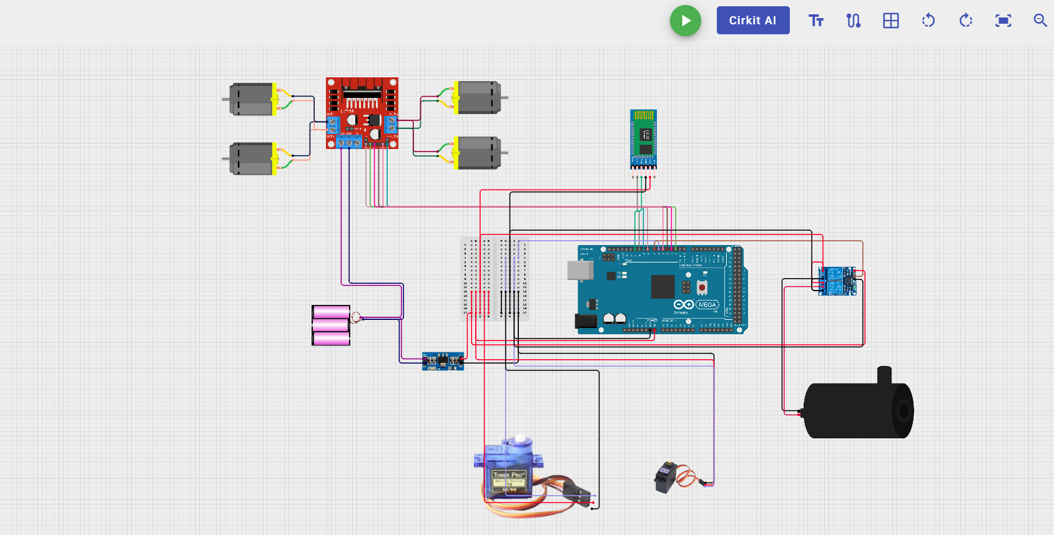
Simulation :

Slide 14
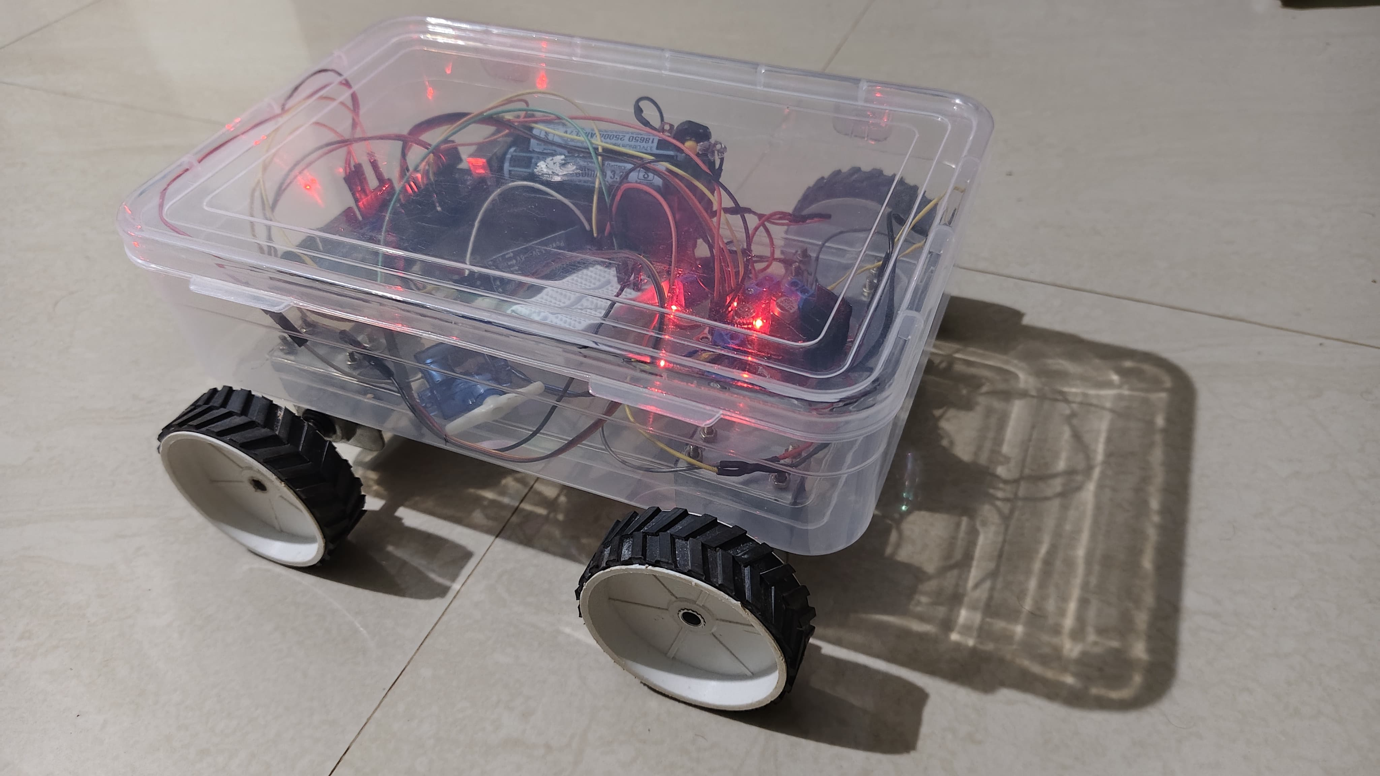
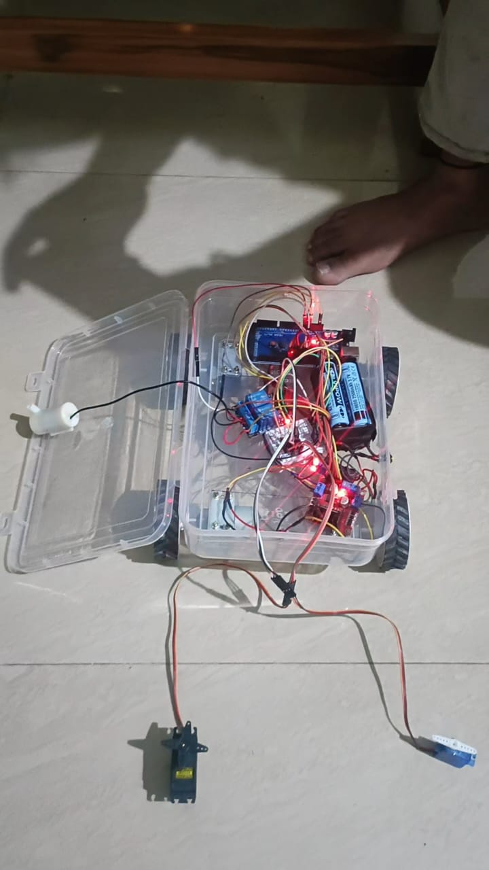
Partial Demonstration of Results :

Slide 15
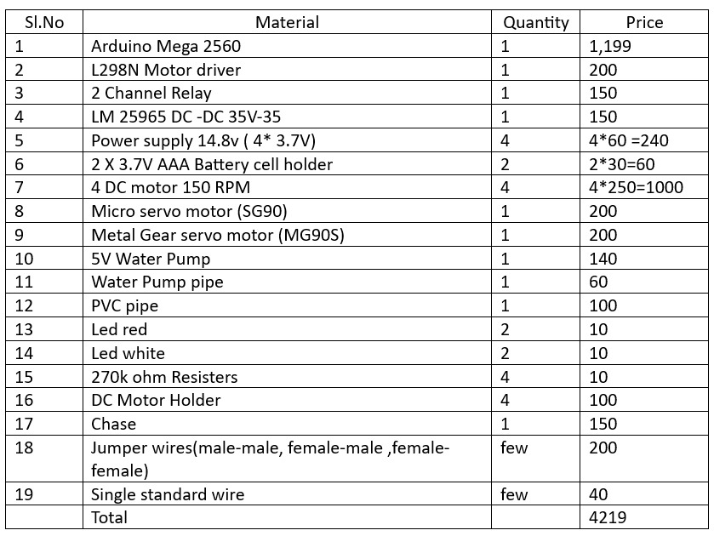
Bill of Material :

Slide 16
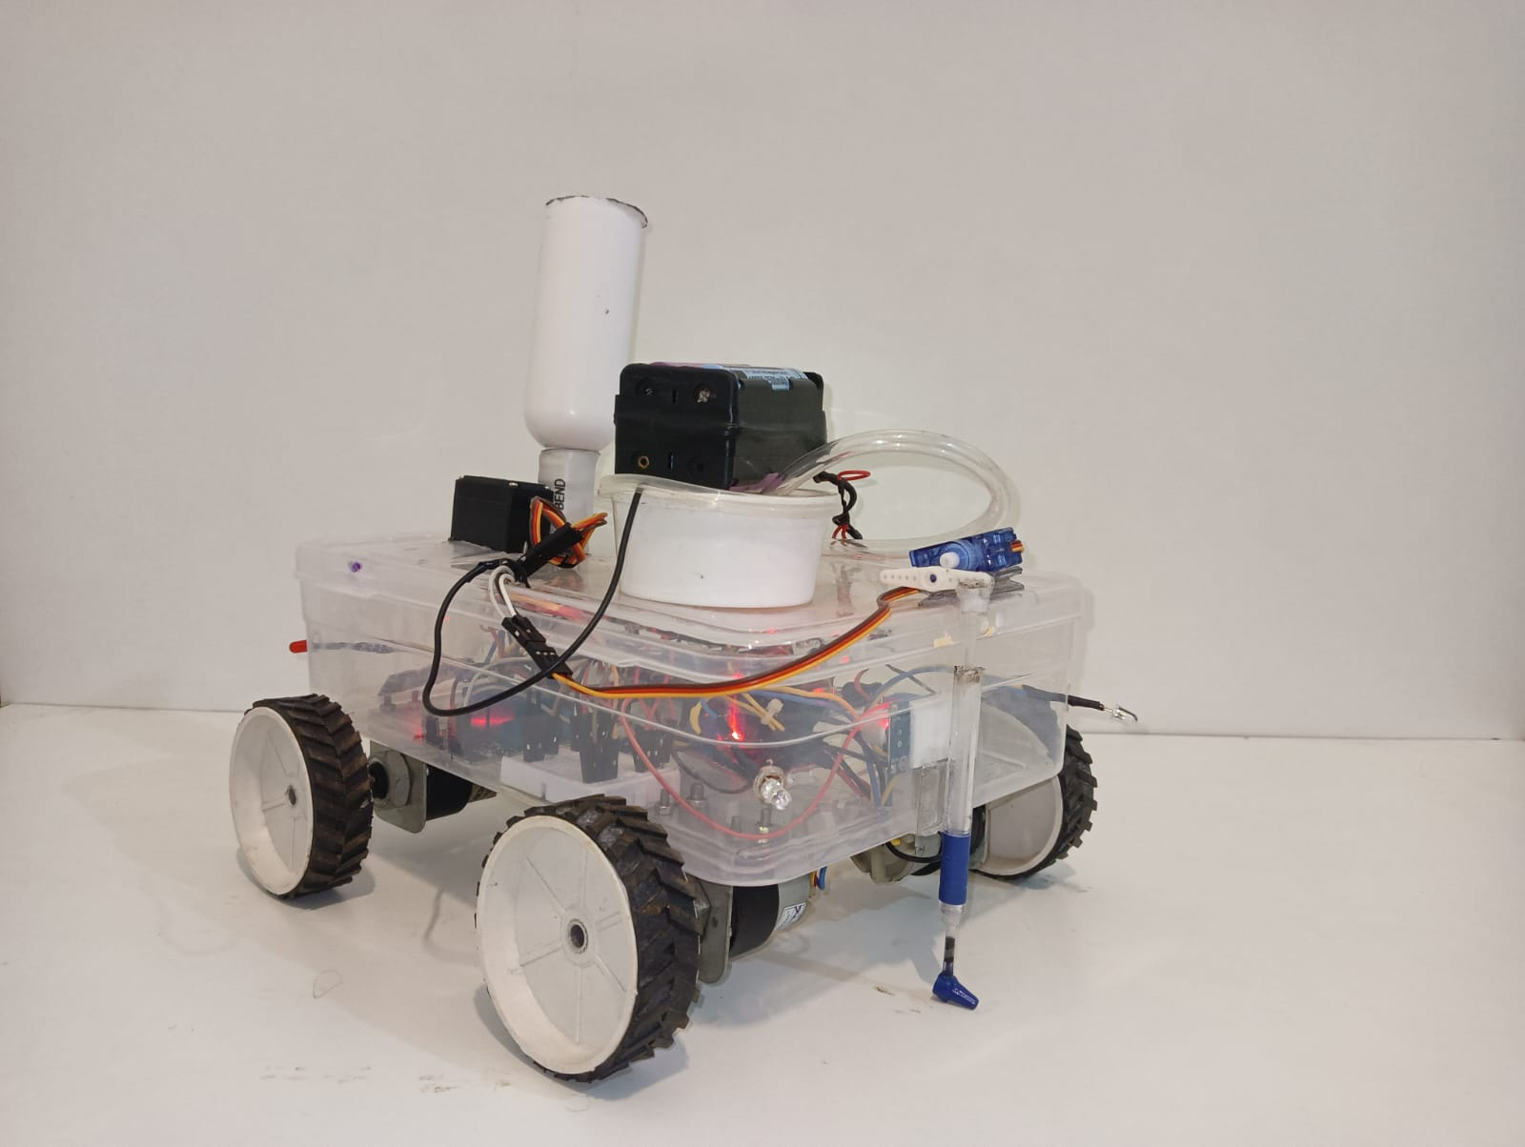
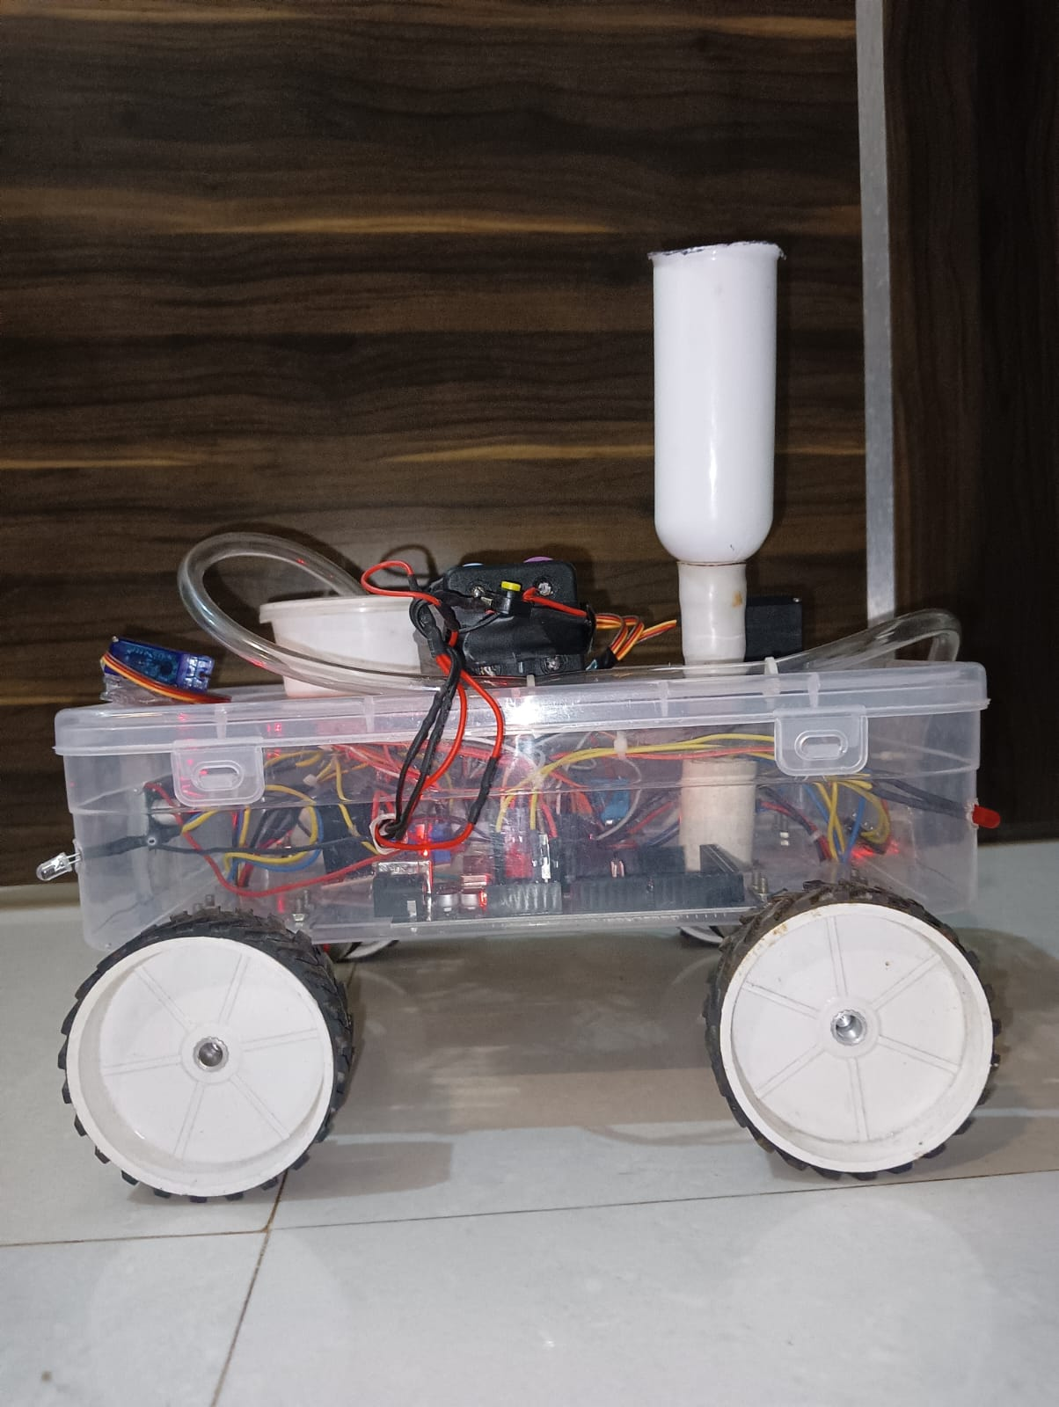
Result :

Slide 17
Conclusion:
The autonomous seed sowing robot marks a significant advancement in agricultural automation by integrating soil digging, seed sowing, soil covering, and water spraying into a single, efficient system. The robot demonstrated reliable performance during testing, with precise seed placement, consistent soil coverage, and effective water distribution, significantly reducing manual effort and improving productivity. Its user-friendly Bluetooth based control system allowed real-time adjustments for seed spacing and water flow, catering to various crop requirements. Despite challenges such as limited adaptability to uneven terrains, handling seeds of varying sizes, and the communication range of the control system, the project highlights a promising solution to modern agricultural challenges like labor shortages and inefficiencies. With further refinements, including terrain adapt ability, extended-range connectivity, and advanced navigation systems, the robot has the potential to revolutionize farming practices, contributing to higher yields, resource optimization, and sustainable agricultural development

Slide 18
Thank You

